Slide 1
Game analysis
Lucy ADHIAMBO
Data Scientist

Slide 2
Introduction
Decoding Gaming Behavior project has a dataset related to a game.
The dataset includes two tables: `Player Details` and `Level Details`.
Below is a brief description of the dataset and the tasks you need to perform: Dataset Description: Player Details Table: • `P_ID`: Player ID • `PName`: Player Name • `L1_status`: Level 1 Status • `L2_status`: Level 2 Status • `L1_code`: System generated Level 1 Code • `L2_code`: System generated Level 2 Code
Level Details Table: • `P_ID`: Player ID • `Dev_ID`: Device ID • `start_time`: Start Time • `stages_crossed`: Stages Crossed • `level`: Game Level • `difficulty`: Difficulty Level • `kill_count`: Kill Count • `headshots_count`: Headshots Count • `score`: Player Score • `lives_earned`: Extra Lives Earned

Slide 3
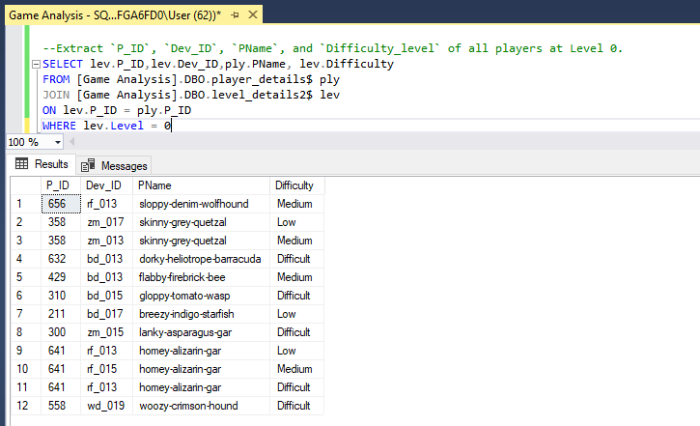
1. Extract `P_ID`, `dev_id`, `pname`, and `difficulty_level` of all players at level 0.

Slide 4
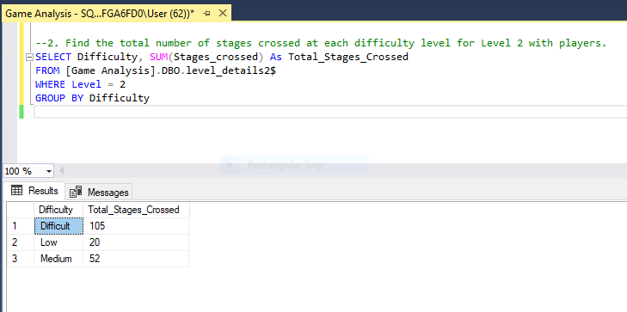
2. Fins the total number of stages crossed at each difficulty level for level 2 with players

Slide 5
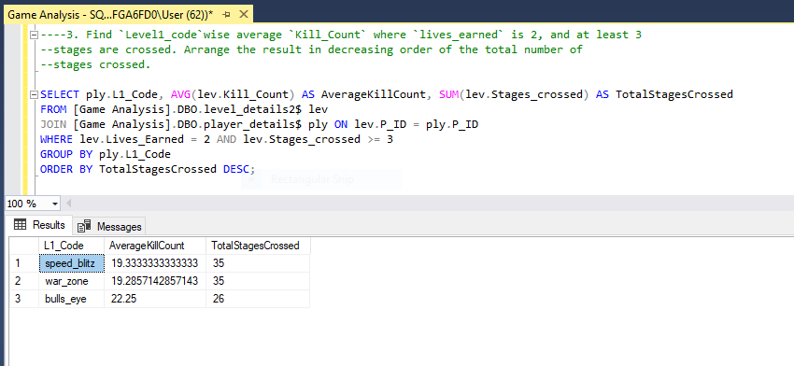
3. Find `level1_code`wise average `kill_count` where `lives_earned` is 2, and at least 3 stages are crossed. Using `zm_series` devices. Arrange the result in decreasing order of the total number of stages crossed.

Slide 6
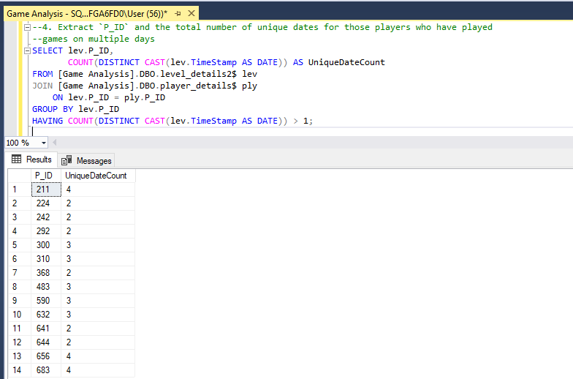
4. Extract `P_ID` and the total number of unique dates for those players who have played games on multiple days

Slide 7
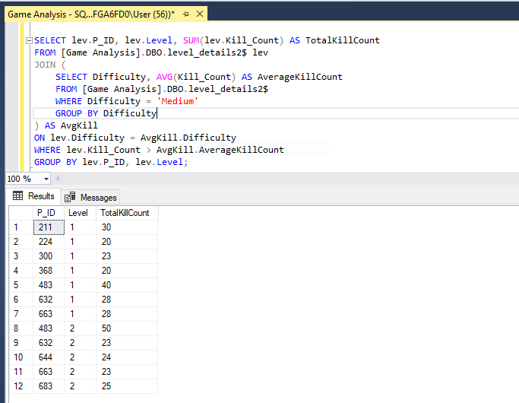
5. Find `P_ID` And Levelwise Sum Of `Kill_counts` Where `Kill_count` Is Greater Than The Average Kill Count For Medium Difficulty

Slide 8
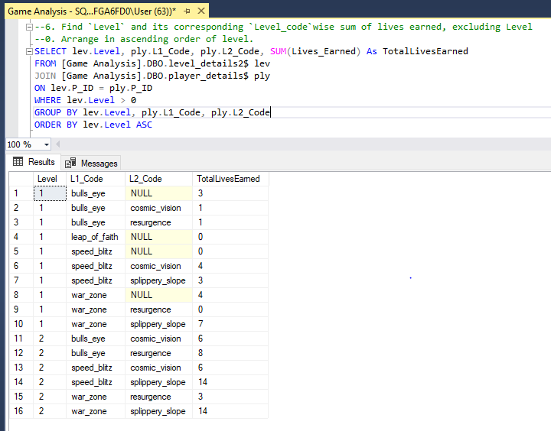
6. Find `Level` And Its Corresponding `Level_code`wise Sum Of Lives Earned, Excluding Level 0. Arrange In Ascending Order Of Level.

Slide 9
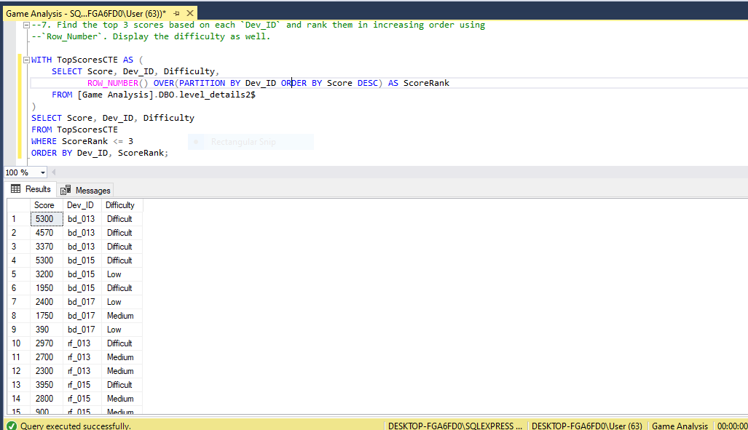
7. Find The Top 3 Scores Based On Each `Dev_id` And Rank Them In Increasing Order Using `Row_number`. Display The Difficulty As Well.

Slide 10
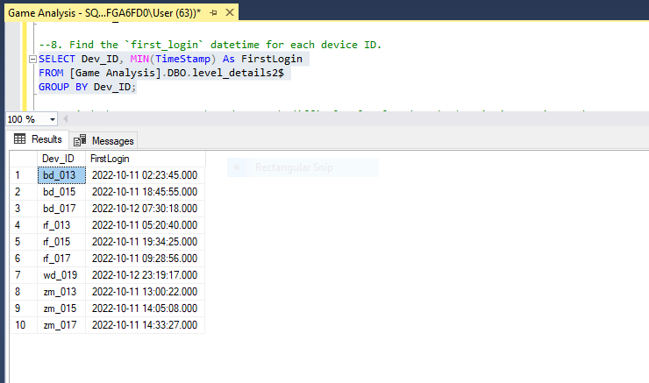
8. Find The `First_login` Datetime For Each Device ID.

Slide 11
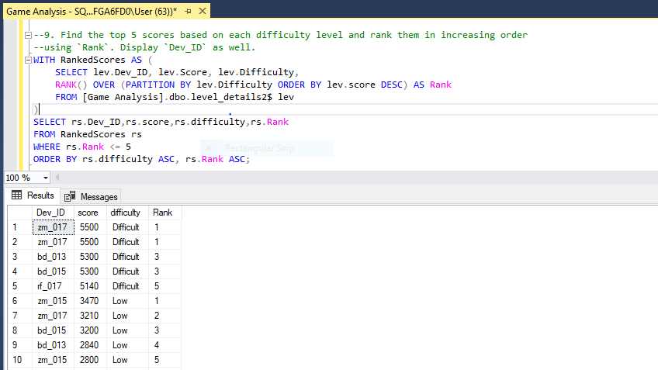
9. Find The Top 5 Scores Based On Each Difficulty Level And Rank Them In Increasing Order Using `Rank`. Display `Dev_id` As Well.

Slide 12
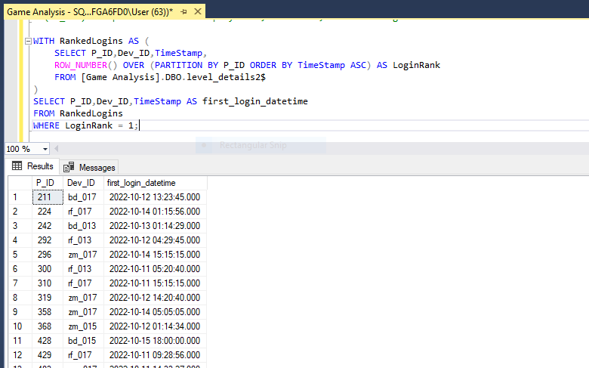
10. Find The Device ID That Is First Logged In (Based On `Start_datetime`) For Each Player (`P_ID`). Output Should Contain Player ID, Device ID, And First Login Datetime.

Slide 13
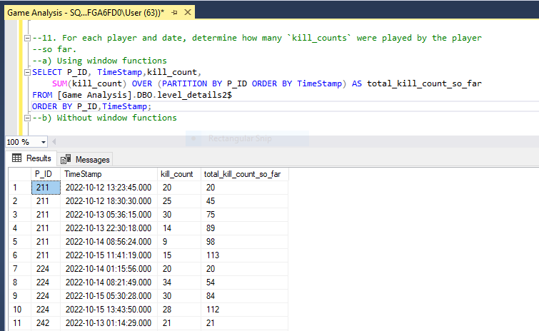
11. For Each Player And Date, Determine How Many `Kill_counts` Were Played By The Player So Far. A) Using Window Functions

Slide 14
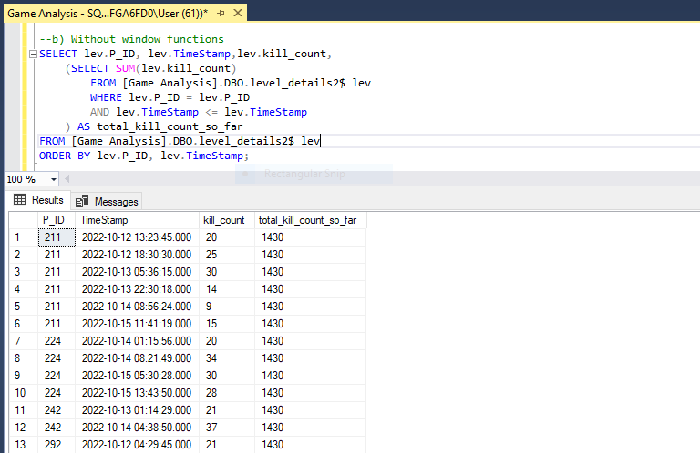
B) Without Window Functions

Slide 15
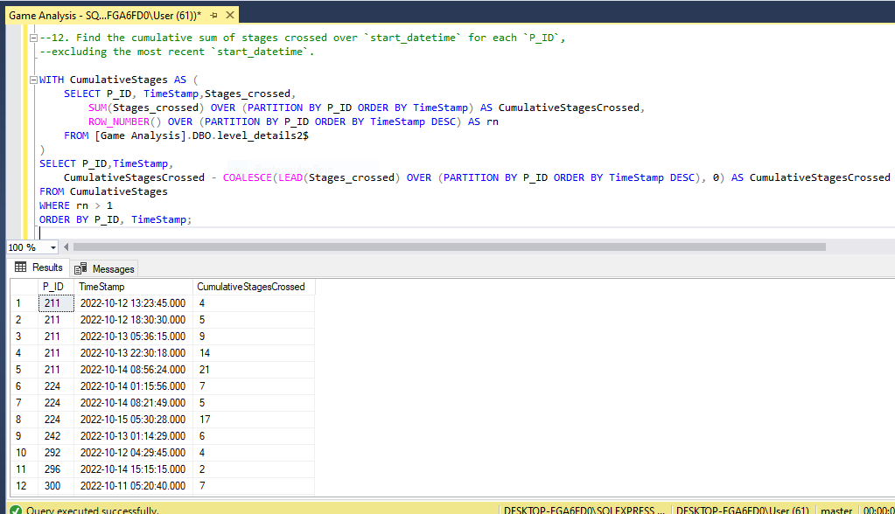
12. Find The Cumulative Sum Of Stages Crossed Over `Start_datetime` For Each `P_ID`, Excluding The Most Recent `Start_datetime`.

Slide 16
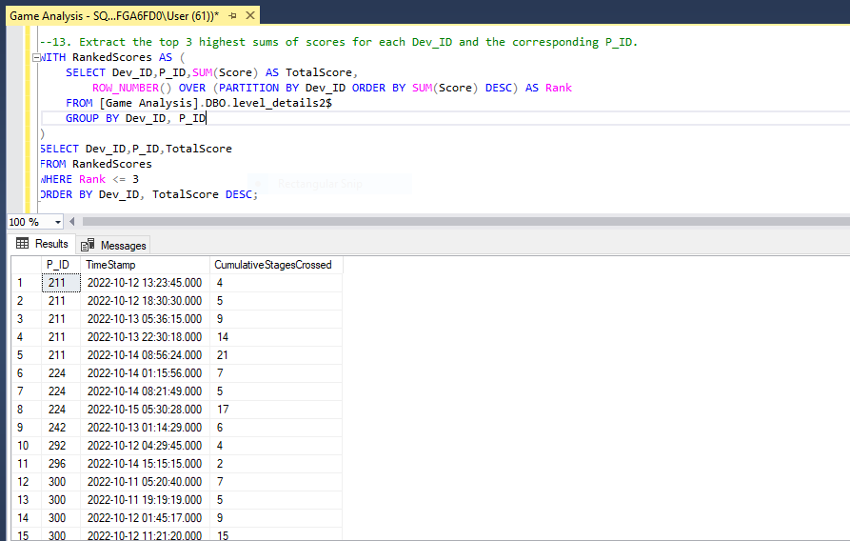
13. Extract The Top 3 Highest Sums Of Scores For Each `Dev_id` And The Corresponding `P_ID`.

Slide 17
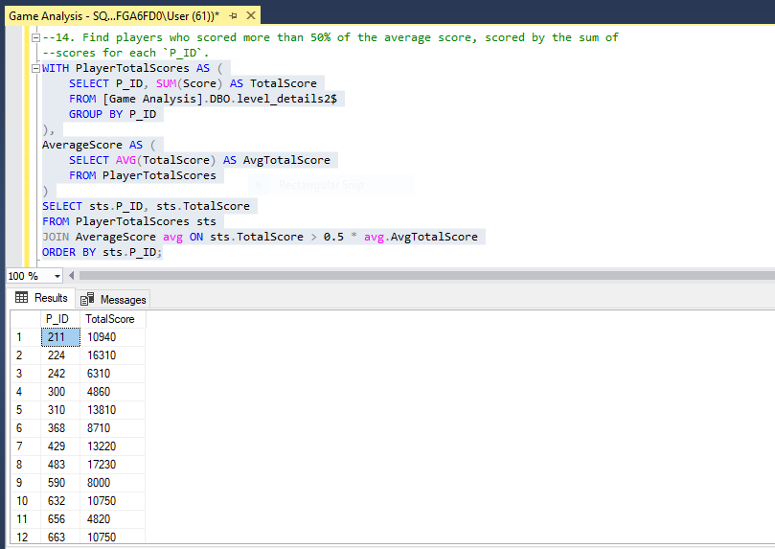
14. Find Players Who Scored More Than 50% Of The Average Score, Scored By The Sum Of Scores For Each `P_ID`.

Slide 18
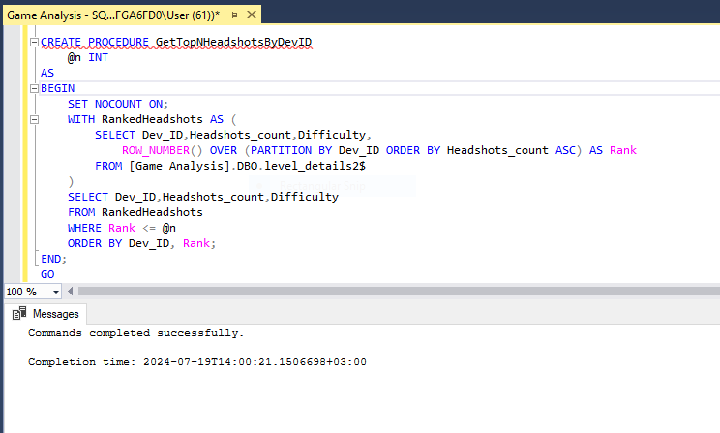
15. Create A Stored Procedure To Find The Top `N` `Headshots_count` Based On Each `Dev_id` And Rank Them In Increasing Order Using `Row_number`. Display The Difficulty As Well.

